Slide 1
Publication Bias and Other Sensitivity Analyses in Meta-Analysis
Michael A. McDaniel
Virginia Commonwealth University
CARMA November 9, 2012

Slide 2
Overview of Presentation
Begin with the shortest ever explanation of meta-analysis (2 slides).
Introduce sensitivity analysis in meta-analysis.
Briefly review a few non-publication bias approaches to sensitivity analysis.
Focus on publication bias as a sensitivity analysis:
  From where publication bias arises
  Overview methods for detection and correction.

Slide 3
Meta-Analysis of Correlations between Truth and Beauty
Sample | N | Effect Size
Manny (1983) | 250 | .17
Moe (1995) | 114 | .25
Jack (2004) | 617 | .20
Zappa (2011) | 45 | .39
Calculate the mean and variance of the effect size (e.g., r) distribution.
Estimate variance due to random sampling error.
Estimate variance that is not due to random sampling error.
Seek to explain non-sampling error variance.

Slide 4
Meta-Analysis with Corrections
Sample | N | r | r_{xx} Truth | r_{yy} Beauty | Range Rest.(U)
Manny (1983) | 250 | .17 | .76 | .88 | .70
Moe (1995) | 114 | .25 | .85 | .84 | .84
Jack (2004) | 617 | .20 | .84 | .76 | .76
Zappa (2011) | 45 | .39 | .89 | .78 | .90
Estimate the mean and variance of a population distribution in which 1) variables are assessed without measurement error 2) variables have no restriction in their range.
Seek to explain non-sampling error and non-artifactual variance.

Slide 5
Sensitivity Analysis

Slide 6
Sensitivity Analysis
A sensitivity analysis examines the extent to which results and conclusions are altered as a result of changes in data or analysis approach (Greenhouse & Iyengar, 2009).
If the conclusions do not change as a result of the sensitivity analysis, one can state that they are robust and one can have greater confidence in the conclusions.

Slide 7
Sensitivity Analysis
Sensitivity analyses are seldom conducted in meta-analyses in the social and organizational sciences.
  Only 16% of meta-analyses conducted sensitivity analyses (Aguinis et al., 2001)
Because meta-analyses have a strong impact on literatures, sensitivity analyses need to become much more common (and reported) in meta-analyses.

Slide 8
Sensitivity Analysis:
Outliers
One form of sensitivity analysis is to conduct meta-analyses with and without outliers.
  Effect size outlier (large or small)
    Graphical methods and statistical tests for outliers (Beal, Corey, & Dunlap, 2002)
  Sample size outlier (large)
    Sample sizes influence effect size weights in meta-analyses.

Slide 9
Sensitivity Analysis:
One Sample Removed
Repeat the meta-analysis multiple times, each time leaving out one sample.
This yields as many means as samples. Examine the means.
How much does the distribution mean change when a given sample is excluded from the analysis?
Are the results due to a small number of influential samples?

Slide 10
Sensitivity Analysis:
Operational Definitions
Measures of a given construct often vary within a meta-analysis.
Beauty might be measured by:
  Self-report
  Observations of others
  Facial or body symmetry
The magnitude of effects may co-vary with the operational definitions of variables.
Are the results due to a specific operational definition?

Slide 11
Sensitivity Analysis:
Data Imputations
Typically, one does not include a sample in a meta-analysis if the sample size and effect size are not known with certainty.
However, meta-analyses that involve corrections for artifacts (i.e., measurement error or range restriction) often need to impute at least some of the artifacts for some of the samples.

Slide 12
Sensitivity Analysis:
Data Imputations
Consider various imputed values.
After you identify what you believe are the best imputations, create sets of artifacts that have higher values, sets with lower values, and sets with more or less variance.
How robust are the conclusions to varying assumptions about the mean and variability of the imputed artifacts?

Slide 13
Sensitivity Analysis:
Publication Bias
Publication bias analyses are a type of sensitivity analysis.
Publication bias exists when the research available to the reviewer on a topic is unrepresentative of all the literature on the topic (Rothstein, Sutton & Borenstein, 2005).
  Availability bias; Dissemination bias
Publication bias can distort a literature.

Slide 14
Sensitivity Analysis:
Publication Bias
  A meta-analysis of a literature distorted by publication bias will yield incorrect results.
  Taxonomy of causes of publication bias (Banks & McDaniel, 2011; Kepes, Banks, McDaniel, Whetzel, 2012)
  Outcome-level causes
  Sample-level causes

Slide 15
Outcome-Level Publication Bias in Primary Studies
(primary study is available but some results are not)
Outcome-level publication bias refers to selective reporting of results (i.e., selective reporting of effect sizes).

Slide 16
Publication Bias:
Outcome-Level
There is substantial evidence of this bias in the medical science literatures.
There is no compelling argument for a different situation in the organizational sciences (Hopewell, Clarke, & Mallett, 2005)

Slide 17
Publication Bias:
Outcome-Level
Sources of this bias include author decisions, the editorial review process, and organizational constraints.

Slide 18
Publication Bias:
Outcome-Level
Authors may decide to exclude some effect sizes prior to submitting the paper.
  Not statistically significant
  Contrary to:
    expected finding
    the author’s theoretical position
    the editor’s or reviewers’ theoretical positions
    past research
  Results which disrupt the paper’s story line.

Slide 19
Publication Bias:
Outcome-Level
Authors may also:
  Choose the analytic method that maximizes the magnitude of the effect size.
    Not report the effect size under alternative analysis methods.
  Delete the effect sizes that are not consistent with expected results.
  Manufacture false results (Yong, 2012).

Slide 20
Publication Bias:
Outcome-Level
Authors may engage in HARKing (hypothesizing after results are known) (Kerr, 1998).
HARKing may involve deleting some effect sizes.
Citing Rupp (2011, p. 486): HARKing serves to “convert Type I errors into non-replicable theory, and hides null results from future generations of researchers.”

Slide 21
:
Publication Bias:
Outcome-Level
A survey reported that 92% of faculty state that they know of a colleague who has engaged in HARKing (Bedeian,Taylor & Miller, 2010) .
This a sad state of affairs.

Slide 22
:
Publication Bias:
Outcome-Level
For disciplines that use many control variables, a researcher can go “fishing” for the control variables that yield the expected results.
Discard the control variables that yield results inconsistent with the expected result.
Fail to report the effect sizes prior to “fishing.”

Slide 23
:
Publication Bias:
Outcome-Level
The editorial review process can result in outcome-level bias. An editor may:
  Request that the author change the focus of the paper making some results less relevant.
  Request that the author shorten the paper.
  Request that the author drop the analyses yielding statistically non-significant effect sizes.
Reviewers may promote HARKing by knowing the results and then offering alternative explanations.

Slide 24
Sample-Level Publication Bias
(the entirely missing primary study)
Sample-level causes of publication bias concern the non-availability of an entire sample.

Slide 25
:
Publication Bias:
Sample-Level
Sources of this bias include author decisions, the editorial review process, and organizational constraints.

Slide 26
:
Publication Bias:
Sample-Level
Research in medicine suggests that author decisions are the primary cause of non-publication (Dickerson, 1990, 2005).
  An author will likely work on the paper that has the best chance of getting into the best journal.
  Other papers are abandoned.
  Results in small magnitude effects being hidden from the research literature.

Slide 27
:
Publication Bias:
Sample-Level
Authors may have personal norms or adopt organizational norms which hold that only articles in the top journals “count.”
  Count for tenure, promotions, raises, discretionary dollars.
Thus, authors may abandon papers that don’t make the top journal cut.
Results are lost to the literature.

Slide 28
:
Publication Bias:
Sample-Level
The editorial process will reject papers:
  Poorly framed papers
  Papers without statistically significant findings
  Papers with results contrary to existing literature and current theory
  Well done research that “didn’t work”

Slide 29
Publication Bias:
Sample-Level
These editorial decisions result in suppression of effect sizes at the sample level.
Typically, samples with smaller magnitude effect sizes will be lost.

Slide 30
:
Publication Bias:
Sample-Level
To clarify, I think editors should reject papers that are bad (e.g., bad framing, lack of clear focus, incomplete theory, poorly developed hypotheses, awful measures, poor design, incompetent analysis).
Just don’t define “bad” as:
  Small effect sizes
  Results inconsistent with hypotheses

Slide 31
:
Publication Bias:
Sample-Level
Organizations may not give permission to report some findings.
  Organizations are unlikely to permit release of a paper if it documents that employment decisions (e.g., selection, layoffs, raises, or bonuses) show demographic differences.

Slide 32
:
Publication Bias:
Sample-Level
Some research is asserted to be proprietary.
  Try requesting technical documentation from employment test vendors who claim that their employment test has much smaller demographic differences than typically observed.

Slide 33
:
Publication Bias
Neither outcome-level publication bias nor sample-level publication bias results in a “missing data at random” situation.
  Not missing at random (NMAR)
There is nothing random about it.

Slide 34
Is Publication Bias in Our Literatures?
Dalton, Aguinis, Dalton, Bosco, and Pierce, (2012, p. 222): Publication bias “does not produce an inflation bias and does not pose a serious threat to the validity of meta-analytically derived conclusions.”
  Vote counting study of the significance and non-significance of correlations.
  Took a broad inferential leap.

Slide 35
Is Publication Bias in Our Literatures?
Dalton et al. note a potentially important limitation of their study:
  “We have not, however, established this phenomenon at the focal level. Our data do not provide an insight into whether such comparisons would maintain for studies—published and nonpublished—particularly focused on, for example, the Big Five personality traits or employee withdrawal behaviors (e.g., absenteeism, transfers, and turnover).” (p. 244)

Slide 36
Is Publication Bias in Our Literatures?
When examining at a focal level (a literature on a specific topic), publication bias appears to be relatively common.
Ferguson and Brannick (2012) examined meta-analyses in the psychological literature.
  “Publication bias was worrisome in about 25% of meta-analyses” (p. 120)

Slide 37
Is Publication Bias in Our Literatures?
Judgment and decision making (Renkewitz, Fuchs, & Fiedler, 2011)
Test vendor validity data (McDaniel, Rothstein, Whetzel, 2006; Pollack & McDaniel, 2008)
Conditional Reasoning Test validity (Banks, Kepes, & McDaniel, 2012)
Big 5 validity (Kepes, McDaniel, Banks, Hurtz, & Donovan, 2011)
Reactions to training (Kepes, Banks, McDaniel, & Sitzmann, 2012)

Slide 38
Is Publication Bias in Our Literatures?
Relation between work experience and performance (Kepes, Banks, & Oh, in press)
Gender differences on transformational leadership (Kepes, Banks, & Oh, in press)
Pygmalion interventions (Kepes, Banks, & Oh, in press)

Slide 39
Is Publication Bias in Our Literatures?
Journal-published mean racial differences in personality (Tate & McDaniel, 2008)
Journal-published mean racial differences in job performance (McDaniel, McKay, & Rothstein, 2006)

Slide 40
Increase in Publication Bias Studies
In the next few years, we will likely see many more studies examining publication bias on topics in strategy, entrepreneurship and other organizational sciences.

Slide 41
Increase in Publication Bias Studies
Publication bias analyses of already completed meta-analyses are relatively easy to do.
Data are often listed in tables or at least the studies are listed in the reference section.
Software is readily available.
  Although one might hop from one package to another: R, Stata, CMA

Slide 42
Methods
Kepes, S., Banks, G.C., McDaniel, M.A., & Whetzel, D.L. (2012). Publication bias in the organizational sciences. Organizational Research Methods, 15, 624-662.

Slide 43
Fail Safe N
Rosenthal (1979) introduced what he called the “file drawer problem.”
  Argument is one of sample level bias
  His concern was that some non-significant studies may be missing from an analysis (i.e., hidden in a file drawer) and that these studies, if included, would “nullify” the observed effect.

Slide 44
Fail Safe N
Rosenthal suggested that rather than speculate on whether the file drawer problem existed, the actual number of studies that would be required to nullify the effect could be calculated.
Cooper (1979) called this number the fail safe sample size or Fail Safe N.

Slide 45
Fail Safe N
Becker (2005) argued that “Fail safe N should be abandoned” as a publication bias method.
  Different approaches yield widely varying estimates of the Fail Safe N.
  Prone to miss-interpretation and misuse.
  No statistical criteria available to aid interpretation.

Slide 46
Fail Safe N
More from Becker (2005)
  The assumption of a zero effect for the missing studies is likely to be biased (Begg & Berlin, 1988).
  Does not incorporate sample size information (Sutton et al., 2000)

Slide 47
Fail Safe N
Authors should stop using the Fail Safe N.
Editors and reviewers should stop recommending the use the of the Fail Safe N.

Slide 48
Study Source Analyses
A common study source analysis is to compare published vs. unpublished samples.

Slide 49
Study Source Analyses
One is implicitly making the assumptions that:
  The published samples are representative of all published samples.
  The unpublished samples are representative of all unpublished samples.
These assumptions are not likely credible (Hopewell, et al., 2005)

Slide 50
Study Source Analyses
Consider unpublished samples.
  Meta-analyses may oversample from particular sources:
    Unpublished samples in meta-analyses are often authored by those who are authors of the meta-analysis (Ferguson & Brannick, 2012)

Slide 51
Study Source Analyses
Encourage searching for unpublished samples and conduct published vs. unpublished moderator analyses.
That practice alone is an insufficient approach to assessing publication bias.

Slide 52
Symmetry Based Methods
When sampling error is the sole source of variance, and the sampling distribution is symmetrical, then a funnel plot can be examined for symmetry.
A funnel plot is a plot of effect sizes by precision (1/standard error).

Slide 53
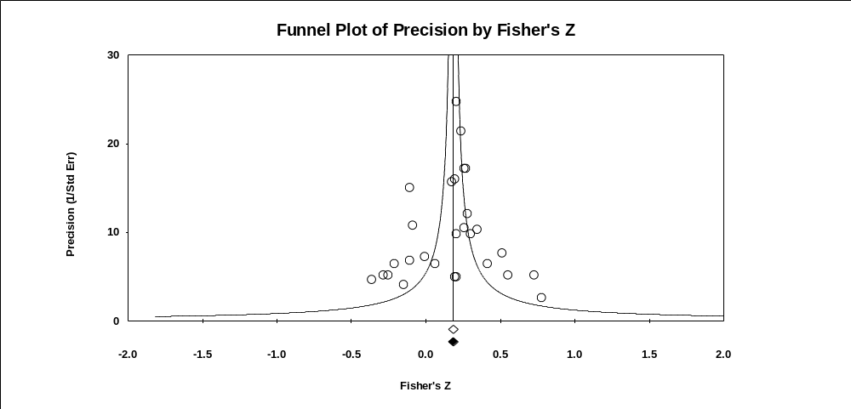

Symmetrical Funnel Plot

Slide 54
Symmetry Based Methods
At non-zero population values, the sampling distribution of a correlation is asymmetrical.
  Transform correlations into Fisher z

Slide 55
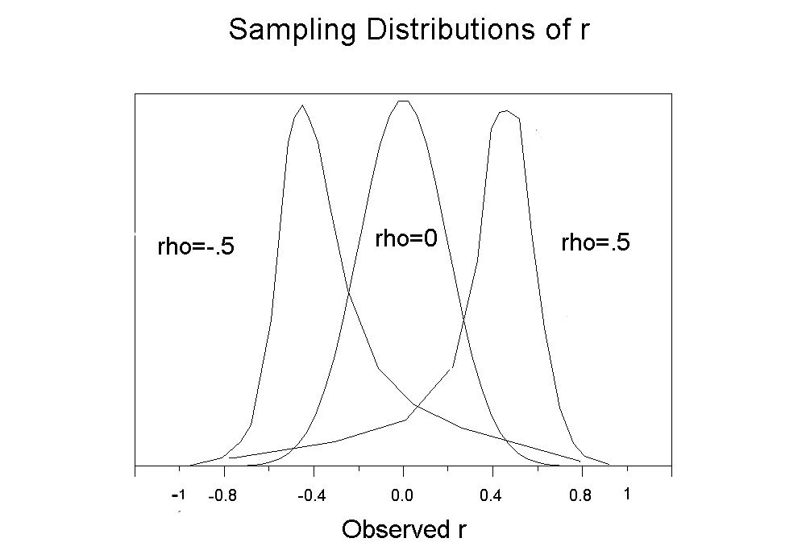
Source: http://luna.cas.usf.edu/~mbrannic/files/regression/corr1.html

Slide 56
Asymmetry May be a Sign of Publication Bias
Asymmetry is typically from the suppression of statistically non-significant effect sizes from small samples.
  Small samples with large effects, likely statistically significant effects, have a higher probability of being published than small samples with non-significant small effects.

Slide 57
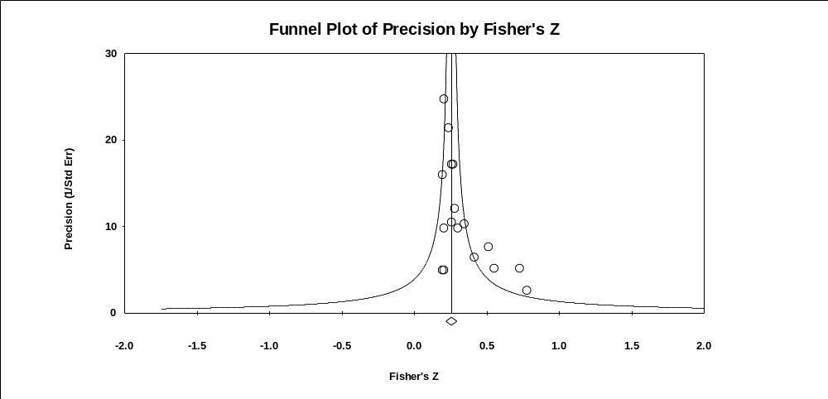
Asymmetrical Funnel Plot

Slide 58
Asymmetry May be a Sign of Publication Bias
Asymmetry may also be due to likely suppressed samples that have larger magnitude effect sizes.
  The suppression would not be a function of statistical significance.
  Larger effects may be suppressed because they are socially uncomfortable.
    Mean demographic differences

Slide 59
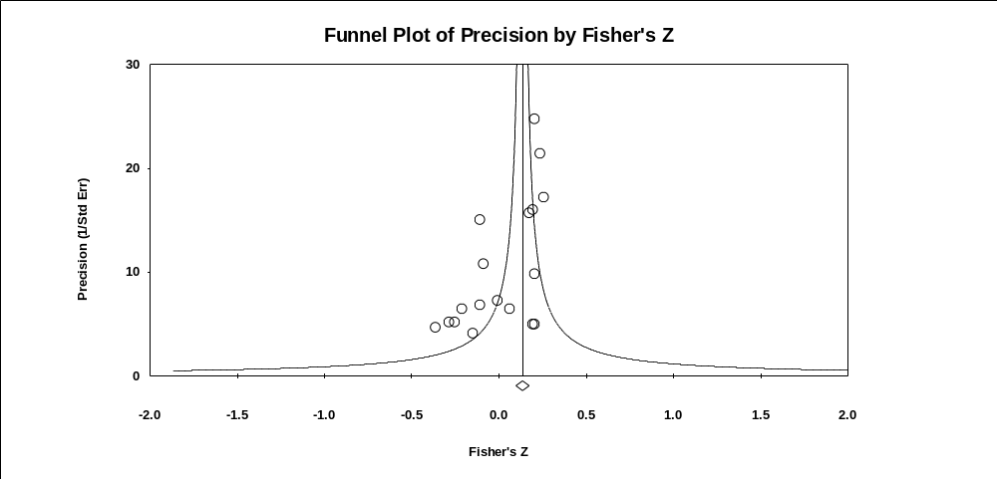
Asymmetrical Funnel Plot

Slide 60
Symmetry Based Methods
Sample size (or precision) should not be correlated with effect size.
  Begg and Mazumdar’s Rank Correlation Test (Begg & Mazumdar, 1994)
  Egger's Test of the Intercept (Egger, Smith, Schneider, & Minder, 1997)
  Duval and Tweedie’s Trim and Fill (Duval, 2005)

Slide 61
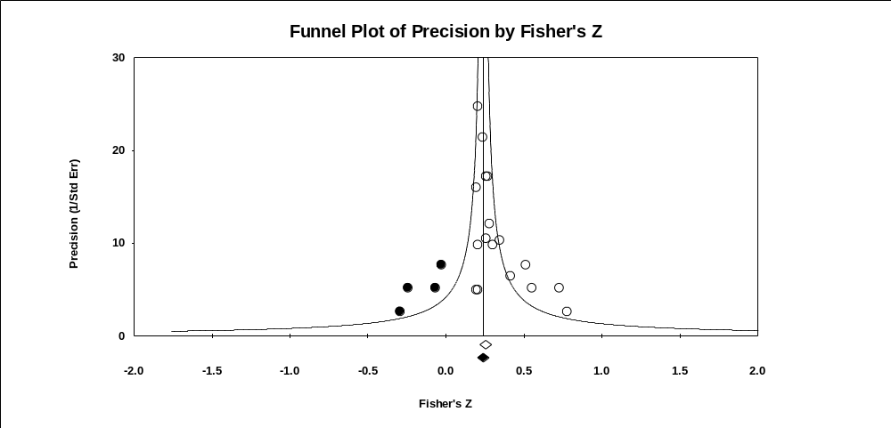
Trim and Fill

Slide 62
Symmetry based methods
Symmetry methods are not robust to violations of the assumption of sampling error being the sole source of variance (e.g., moderator variance) (Terrin, Schmid, Lau, & Olkin, 2003).
Our disciplines abound with moderators. Therefore, apply the methods to relatively moderator free subsets of the data.
  At least 10 effect sizes (Sterne et al., 2011)

Slide 63
Symmetry Based Methods
The trim and fill method is probably the most useful symmetry based method in that it estimates what the population distribution would be if the missing studies were located.
Analyses are re-conducted on the distribution containing both the observed data and the imputed data.

Slide 64
Symmetry Based Methods
It is unwise to consider this distribution of observed and imputed data as the “true” distribution.

Slide 65
Symmetry Based Methods
More reasonable to compare the observed mean with the trim and fill adjusted mean.
  If the mean drops from .45 to .15, one should worry about publication bias.
  But, one should not assume that .15 is the best estimate of the population mean.

Slide 66
Symmetry Based Methods
Some asymmetry is not due to publication bias but to “small sample effects.”
  A medicine may work best with the sickest (small N) patients and work less well with moderately sick (larger N) patients.
  Small sample studies may yield larger effects due to better measures that are more difficult to collect in larger samples.

Slide 67
Symmetry Based Methods
Related to trim and fill is the contour-enhanced funnel plot, which displays graphically whether the imputed samples are a function of statistical significance (Peters et al., 2008).
  Helps separate publication bias effects from “small sample effects.”

Slide 68
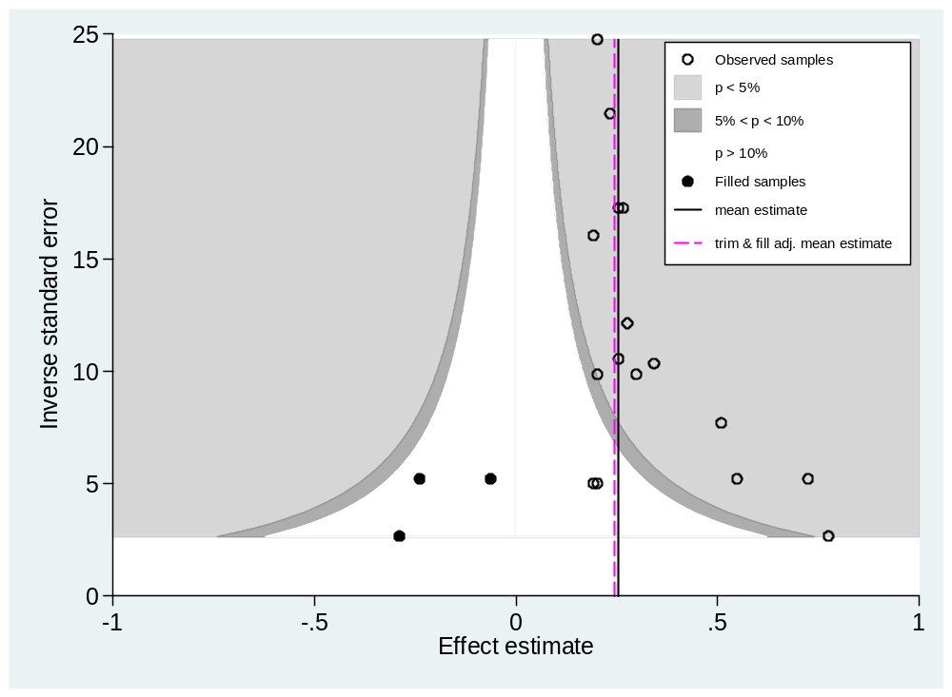
Contour-enhanced
Funnel Plot

Slide 69
Cumulative Meta-Analysis by Precision
Sort samples by sample size or precision.
Conduct a meta-analysis starting with one effect size (the most precise effect) and add an additional effect size (with increasingly less precision) with each iteration of the meta-analysis.
Inspect the meta-analytic means for drift.

Slide 70
Cumulative Meta-Analysis by Precision
Pollack and McDaniel (2008) showed some drift consistent with an inference of publication bias (although the mean did not change radically).

Slide 71
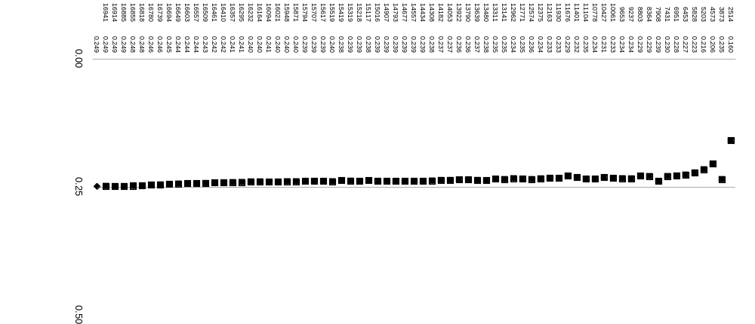
The most precise sample (N=2,514), has an effect size of .16.
With 4 studies needed to bring the N to over 5,000, the mean effect size is .22.
With 40 studies needed to bring the N to over 15,000, the mean effect size is .24.
By the time one gets to 70 studies (N = 16,941), the mean effect size is .25.

Slide 72
Cumulative Meta-Analysis by Precision
Gives similar results to that obtained in symmetry based methods.
  When symmetry analyses suggest small effects are suppressed, cumulative meta-analysis will show a drift toward larger effects.
  When symmetry analyses suggest larger effects are suppressed, cumulative meta-analysis will show a drift toward smaller effects.

Slide 73
Cumulative Meta-Analysis by Precision
Possibly less affected by moderator induced heterogeneity.
  Need more research
Need research on heuristics for when to judge a drift meaningful.

Slide 74
Cumulative Meta-Analysis by Date of Publication
Ioannidis has been very active in demonstrating that effect sizes from the earliest published studies typically overestimate population values (e.g., Ioannidis and Trikalinos 2005).
Proteus phenomenon
  (from Greek "πρῶτος" - protos, "first")
Smaller effect size studies appear to take longer to get published.

Slide 75
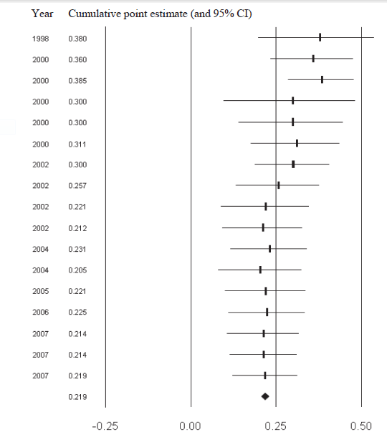
Year Cumulative point estimate (and 95% CI)
Cumulative correlation of conditional reasoning test with job performance by year (Banks, Kepes, & McDaniel, 2012)
Earliest studies, on average, show the largest effects.

Slide 76
Selection Models
Selection models, also called weight-function models, originated in econometrics to estimate missing data at the item level.
Hedges and Vevea introduced the method to the publication bias literature (Hedges, 1992; Vevea & Hedges, 1995).
Relatively robust to heterogeneity (e.g., moderators) (Vevea & Woods, 2005)

Slide 77
Selection Models
As with trim and fill, selection models estimate what the population distribution would be if the missing studies were located.

Slide 78
Selection Models
When one is conducting a meta-analysis without regard to suppressed studies, one is implicitly assuming that one has 100% of the completed studies.
Selection models permit you to make other assumptions.

Slide 79
Selection Models
Selection models assume that the probability that an effect size is included in a distribution is a function of a characteristic of that effect size.
  This characteristic is usually the level of statistical significance.
Consider an a priori assumed selection model.

Slide 80
An a priori assumed selection model
Significance level | Probability of being in the distribution
p <.001 | 100%
.001 < p < .049 | 90%
.049 < p < .10 | 70%
p > .10 | 30%

Slide 81
Selection Models
Given an a priori assumed selection model, what would the mean effect be if samples at all statistical significance levels have a 100% probability of inclusion in the distribution?
In practice, one may create an a priori selection model with moderate publication bias and another with severe bias and compare the means to the original meta-analytic mean.

Slide 82
Meta-regression
A meta-regression is a regression in which the effect size is the dependent variable and potential moderators are the independent variables.
Egger's Test of the Intercept was noted earlier as a symmetry based method (Egger et al., 1997).

Slide 83
Meta-regression
Egger’s Test examines whether precision is related to the magnitude of an effect size.
Thus, Egger’s Test is conceptually similar to a meta-regression with precision as the single independent variable.
Effect size = a + b₁(precision)

Slide 84
Meta-regression
However, other variables (potential moderator variables) could be included:
  Effect size = a + b₁(precision) + b₂(moderator)
Thus, a single regression might be able to simultaneously evaluate moderators and the presence of publication bias.

Slide 85
Meta-regression
Economists are advocates of this approach.
  Consider Doucouliagos and Stanley (2009); Stanley (2008); and Stanley and Doucouliagos (2011).

Slide 86
Trim & Fill Meta-Regression
Begin with a meta-regression where independent variables are moderators.
Apply a version of trim and fill to residuals. Impute residuals as needed for symmetry.
Compare original meta-regression to trim and fill meta-regression
  Weinhandl & Duval (2012)

Slide 87
Prevention of
Publication Bias

Slide 88
Prevention
Extremely thorough literature review:
  Published
  Unpublished
  Dissertations
  Conference papers
  Master’s theses
  Foreign language papers
  Personal communication with every researcher in the literature
See Rothstein (2012)

Slide 89
Prevention
Research registries (Berlin & Ghersi, 2005):
  Database where researchers register the studies that they plan to conduct, are in the process of conducting, or have already conducted (Banks & McDaniel, 2011; Berlin & Ghersi, 2005).
  Education (What Works Clearinghouse; U.S. Department of Education)
  Social work (Campbell Collaboration)
  Many registries exist in medical research domains.

Slide 90
Prevention
Changes in the journal review process.
  Many medical journals will not accept studies for review unless the study has been pre-registered.
  Many medical journals allow for supplemental materials to be offered and made available on the web.
  Release data (after a time)
  These journal practices should reduce suppression of effect sizes.

Slide 91
Prevention
Journals could base acceptance/rejection decisions on the introduction and the method sections of the paper (see Schminke, 2010)
  At least some reviewers would not see the results and discussion.
  Places less reliance on statistical significance as a criterion for acceptance.

Slide 92
Prevention
Alter author and organizational norms concerning the value of publications in less than elite journals.
  Stop encouraging the abandonment of research studies when they cannot get into an “A” journal.
  Abandonment of research is a very damaging practice for our research literatures.
    Many of our “best” universities are promoting the abandonment of research studies.

Slide 93
Prevention
Alter top journals’ obsession with strong theoretical contributions.
Hambrick (2007), p. 1349 as cited in Leung (2011):
  “… what we see too often in our journals: a contorted, misshapen, inelegant product, in which an inherently interesting phenomenon has been subjugated by an ill-fitting theoretical framework”.

Slide 94
Suggested Research Program to Estimate the Extent of Publication Bias

Slide 95
Research program in estimating publication bias
Track paper from one point in time to another.
  Start with dissertations and track the manuscript through the conference and publication cycle to see differences between the results in the dissertation and the results in the final journal article.
    Which type of results never got accepted at a journal? (hint: those with statistically insignificant findings)
    Evidence of HARKing

Slide 96
Research program in estimating publication bias
Or, start with submission to a conference (e.g., SIOP, AOM) and track the paper through the conference and publication cycle to see differences between the results in the conference submissions and the results in the journal article.

Slide 97
Thank you.

Slide 98
References
Aguinis, H., Pierce, C. A., Bosco, F. A., Dalton, D. R., & Dalton, C. M. (2011). Debunking myths and urban legends about meta-analysis. Organizational Research Methods, 14, 306-331. doi: 10.1177/1094428110375720
Banks, G.C. & McDaniel, M.A. (2011). The kryptonite of evidence-based I-O psychology. Industrial and Organizational Psychology: Perspectives on Science and Practice, 4, 40-44. doi: 10.1111/j.1754-9434.2010.01292.x
Banks, G.C., Kepes, S., & McDaniel, M.A. (2012). Publication bias: A call for improved meta-analytic practice in the organizational sciences. International Journal of Selection and Assessment, 20, 182-196. doi: 10.1111/j.1468-2389.2012.00591.x
Beal, D. J., Corey, D. M., & Dunlap, W. P. (2002). On the bias of Huffcutt and Arthur's (1995) procedure for identifying outliers in the meta-analysis of correlations. Journal of Applied Psychology, 87, 583-589. doi: 10.1037/0021-9010.87.3.583
Becker, B. J. (2005). The failsafe N or file-drawer number. In H. R. Rothstein, A. J. Sutton, & M. Borenstein (Eds.), Publication bias in meta analysis: Prevention, assessment, and adjustments (pp. 111-126). West Sussex, UK: Wiley.

Slide 99
Bedeian, A.G., Taylor, S,G. & Miller, A. N. (2010). Management science on the credibility bubble: Cardinal sins and various misdemeanors. Academy of Management Learning & Education, 9, 715–725. doi: 10.5465/amle.2010.56659889
Begg, C. B., & Mazumdar, M. (1994). Operating characteristics of a rank correlation test for publication bias. Biometrics, 50, 1088-1101. doi:10.2307/2533446
Begg, C.B. & Berlin, J.A. (1988). Publication bias: A problem in interpreting medical data. Journal of the Royal Statistical Society. Series A (Statistics in Society), 151, 419-463. doi: 10.2307/2982993
Berlin, J.A. & Ghersi, D. (2005). Preventing publication bias: Registries and prospective meta-analysis. In H. R. Rothstein, A. J. Sutton, & M. Borenstein (Eds.), Publication bias in meta analysis: Prevention, assessment, and adjustments (pp. 35-48). West Sussex, UK: Wiley.
Cooper H. M. (1979). Statistically combining independent studies: A meta-analysis of sex differences in conformity research. Journal of Personality and Social Psychology, 37, 131–146. doi: 10.1037/0022-3514.37.1.131

Slide 100
Dalton, D. R., Aguinis, H., Dalton, C. M., Bosco, F. A., & Pierce, C. A. (2012). Revisiting the file drawer problem in meta-analysis: An assessment of published and non-published correlation matrices. Personnel Psychology, 65, 221-249. doi: 10.1111/j.1744-6570.2012.01243.x
Dickersin, K. (1990). The existence of publication bias and risk factors for its occurrence. Journal of the American Medical Association, 263, 1385-1389. doi:10.1001/jama.263.10.1385
Dickersin, K. (2005). Publication bias: Recognizing the problem, understandings its origins and scope, and preventing harm. In H. R. Rothstein, A. J. Sutton, & M. Borenstein (Eds.), Publication bias in meta analysis: Prevention, assessment, and adjustments (pp. 11-34). West Sussex, UK: Wiley.
Doucouliagos, H., & Stanley, T. D. (2009). Publication selection bias in minimum-wage research? A metaregression analysis. British Journal of Industrial Relations, 47, 406-428. doi:10.1111/j.1467-8543.2009.00723.x
Duval, S. J. (2005). The ‘‘trim and fill’’ method. In H. R. Rothstein, A. J. Sutton, & M. Borenstein (Eds.), Publication bias in meta-analysis: Prevention, assessment, and adjustments (pp. 127-144). West Sussex, UK: Wiley.
Egger, M., Smith, G. D., Schneider, M., & Minder, C. (1997). Bias in meta-analysis detected by a simple, graphical test. British Medical Journal, 315, 629-634. doi: 10.1136/bmj.315.7109.629

Slide 101
Ferguson, C. J., & Brannick, M. T. (2012). Publication bias in psychological science: Prevalence, methods for identifying and controlling, and implications for the use of meta-analyses. Psychological Methods, 17, 120–128. doi:10.1037/a0024445
Greenhouse, J. B., & Iyengar, S. (2009). Sensitivity analysis and diagnostics. In H. Cooper, L. V. Hedges & J. C. Valentine (Eds.), The handbook of research synthesis and meta-analysis (2nd ed.). (pp. 417-433): New York, NY, US: Russell Sage Foundation.
Hambrick, D.C. (2007). The field of management's devotion to theory: Too much of a good thing? Academy of Management Journal, 50, 1348-1352. doi 10.5465/AMJ.2007.28166119
Hedges, L. V. (1992). Modeling publication selection effects in meta-analysis. Statistical Science, 7, 246-255. doi:10.1214/ss/1177011364
Hopewell, S., Clarke, M., & Mallett, S. (2005). Grey literature and systematic reviews. In H. R. Rothstein, A. J. Sutton, & M. Borenstein (Eds.), Publication bias in meta analysis: Prevention, assessment, and adjustments (pp. 48-72). West Sussex, UK: Wiley.
Ioannidis J. P. A. & Trikalinos T. A. (2005). Early extreme contradictory estimates may appear in published research: the Proteus phenomenon in molecular genetics research and randomized trials. Journal of Clinical Epidemiology, 58:543-9. doi: 10.1016/j.jclinepi.2004.10.019

Slide 102
Kepes, Banks, McDaniel, & Whetzel (2012). Publication bias in the organizational sciences. Organizational Research Methods, 15, 624-662. doi: 10.1177/1094428112452760
Kepes, S., Banks, G. C., & Oh, I.-S. (in press). Avoiding bias in publication bias research: The value of "null" findings. Journal of Business and Psychology
Kepes, S., Banks, G. C., McDaniel, M. A., & Sitzmann, T. (2012, August). Assessing the robustness of meta-analytic results and conclusions. Paper presented at the annual meeting of the Academy of Management, Boston, MA.
Kepes, S., McDaniel, M. A., Banks, C., Hurtz, G., & Donovan, J. (2011, April). Publication bias and the validity of the Big Five. Paper presented at the 26th Annual Conference of the Society for Industrial and Organizational Psychology. Chicago.
Kerr, N. L. (1998). HARKing: Hypothesizing After the Results are Known. Personality and Social Psychology Review, 2, 196-217. DOI: 10.1207/s15327957pspr0203_4
Leung, K. (2011). Presenting post hoc hypotheses as a priori: Ethical and theoretical issues. Management and Organization Review, 7, 471–479. doi: 10.1111/j.1740-8784.2011.00222.x

Slide 103
McDaniel, M. A., Whetzel, D., Schmidt, F. L., Maurer, S. (1994). The validity of the employment interview: A comprehensive review and meta-analysis. Journal of Applied Psychology, 79, 599-616. doi: 10.1037/0021-9010.79.4.599
McDaniel, M. A., McKay, P. & Rothstein, H. (2006, May). Publication bias and racial effects on job performance: The elephant in the room. Paper presented at the 21st Annual Conference of the Society for Industrial and Organizational Psychology. Dallas.
McDaniel, M. A., Rothstein, H. R. & Whetzel, D. L. (2006). Publication bias: A case study of four test vendors. Personnel Psychology, 59, 927-953. doi: 10.1111/j.1744-6570.2006.00059.x
Peters, J. L., Sutton, A. J., Jones, D. R., Abrams, K. R., & Rushton, L. (2008). Contour-enhanced meta-analysis funnel plots help distinguish publication bias from other causes of asymmetry. Journal of Clinical Epidemiology, 61, 991-996. doi:10.1016/j.jclinepi.2007.11.010
Pollack, J. M. & McDaniel, M. A. (2008, April). An examination of the PreVisor Employment Inventory for publication bias. Paper presented at the 23rd Annual Conference of the Society for Industrial and Organizational Psychology. San Francisco.
Renkewitz, F., Fuchs, H. M., & Fiedler, S. (2011). Is there evidence of publication biases in JDM research? Judgment and Decision Making, 6, 870-881.

Slide 104
Rupp, D.E. (2011). Ethical issues faced by editors and reviewers. Management and Organization Review, 7, 481-493. doi: 10.1111/j.1740-8784.2011.00227.x
Schminke, M. (2010, October) A modest proposal. Paper presented at Society of Organizational Behavior. Birmingham.
Stanley, T. D. (2008). Meta-regression methods for detecting and estimating empirical effect in the presence of publication selection. Oxford Bulletin of Economics and Statistics, 70, 103-127. doi:10.1111/j.1468-0084.2007.00487.x
Rosenthal, R. (1979). The file drawer problem and tolerance for null results. Psychological Bulletin, 86, 638-641. doi: 10.1037/0033-2909.86.3.638
Rothstein, H. (2012). Accessing relevant literature. In H. M. Cooper (Ed.), APA handbook of research methods in psychology: Vol. 1. Foundations, planning, measures, and psychometrics (pp. 133-144). Washington, DC: American Psychological Association.
Rothstein, H. R., Sutton, A. J., & Borenstein, M. (Eds.). (2005). Publication bias in meta-analysis: Prevention, assessment, and adjustments. West Sussex, UK: Wiley.

Slide 105
Stanley, T. D. and Doucouliagos, H. (2011). Meta-Regression Approximations to Reduce Publication Selection Bias. Manuscript available at www.deakin.edu.au/buslaw/aef/workingpapers/papers/2011_4.pdf
Sterne, J. A. C., Sutton, A. J., Ioannidis, J. P., Terrin, N., Jones, D. R., Lau, J., . . . Higgins, J. P. (2011). Recommendations for examining and interpreting funnel plot asymmetry in meta-analyses of randomised controlled trials. British Medical Journal, 343, d4002. doi:10.1136/bmj.d4002
Sutton, A. J., Abrams, K. R., Jones, D. R., Sheldon, T. A., & Song, F. (2000). Methods for meta-analysis in medical research. West Sussex, UK: Wiley.
Tate, B. W. & McDaniel, M. A. (2008, August). Race differences in personality: an evaluation of moderators and publication bias. Paper presented at the Annual meeting of the Academy of Management, Anaheim CA.
Terrin, N., Schmid, C. H., Lau, J., & Olkin, I. (2003). Adjusting for publication bias in the presence of heterogeneity. Statistics in Medicine, 22, 2113-2126. doi:10.1002/sim.1461
Vevea, J. L., & Hedges, L. V. (1995). A general linear model for estimating effect size in the presence of publication bias. Psychometrika, 60, 419-435. doi:10.1007/BF02294384

Slide 106
Vevea, J. L., & Woods , C.M. (2005). Publication bias in research synthesis: Sensitivity analysis using a priori weight functions. Psychological Methods, 10, 428–443.
Weinhandl, E.D., & Duval, S. (2012). Generalization of trim and fill for application in meta-regression. Research Synthesis Methods, 3, 51-67
Yong, E. (2012). Bad copy: In the wake of high profile controversies, psychologists are facing up to problems with replication, Nature, 485, 298-300. doi: 10.1038/485298a

